Slide 1
Event Driven Architecture
Point of View
Jerome Boyer
Distinguished Engineer
Cloud Garage Solution Engineering
boyerje@us.ibm.com
Notes:
This should be my unique deck

Slide 2

Table Of Content
Why EDA in 2018?
Microservice Challenges
Reference Architecture
Kafka and Event Streams
Event Storming Methodology
Even-driven design patterns
Reference Implementation
Data replication for continuous availability
Real time analytics and AI

Slide 3
Event Driven Implementation Journey
Event Storming Workshop
MVP Build Up
Lean Program
Define event-driven app scope
Learn fast and adjust
Transform and scale innovative solutions
Deliver your first solution successfully and quickly
Build foundational platform skills
Use early win to foster new adoption
Demonstrate values
11
11
Established business priorities & objectives
Develop deep empathy for the target users
Process and Event analysis
Define MVP scope to address the opportunity
Replicate success across multiple initiatives leveraging pilot success
Increase agility and maximize delivered business value
Business Outcome
Ignite
Realize
Scale
Notes:
IBM Design Thinking starts by bringing together a series of traditional design techniques, such as personas, empathy maps, design ideation, storyboards, wireframes, and hypothesis-driven design. To these traditional design approaches, IBM Design Thinking adds three core practices: hills, sponsor users, and playbacks

Slide 4
Event Storming Workshop Itinerary
Preparation
Facility
Invite
Day 1
Design Thinking
Define business goals and values
Ramp up
Next steps roadmap
Identify personas and build empathy map
Discover domain events
Playback the process
Day 2 - Event Storming
Find the boundaries
Locate the commands
Describe the data
Identify the aggregates
Define the boundary context
Insight Storming
Architecture decision
MVP prioritization
Day 1 Event Storming
Day 2 - Analytics / MVP

Slide 5
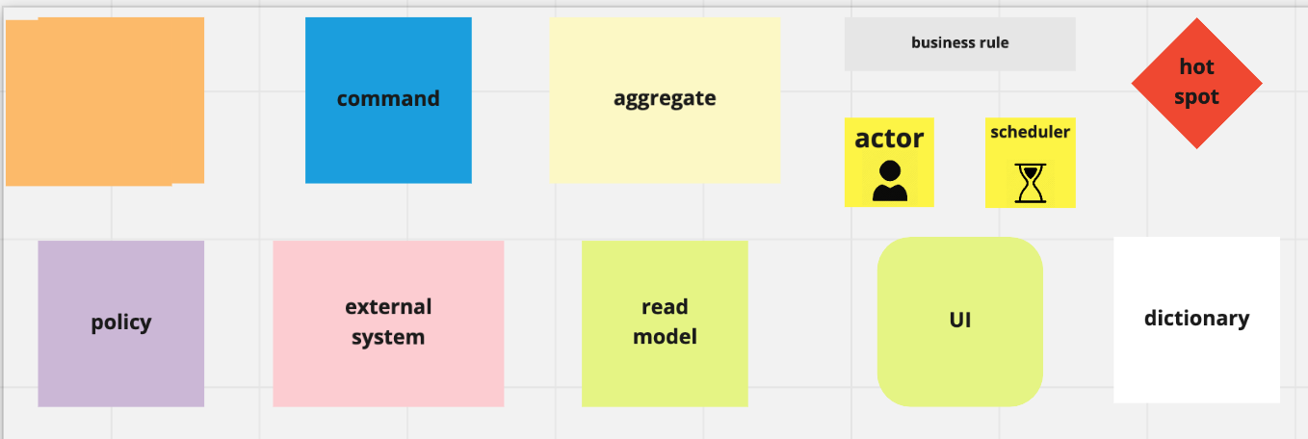


CI/CD pipeline
Understand business objectives
Define Bounded Contexts
Perform developer workspace setup
Identify events
Users feedbacks
Release Loop
Define orchestration and choreography
Define Spring Goals / Plan for playbacks
Gather metrics
Next sprint
Define data models, event schemas, service contracts
Integration
Stage
Production
Deploy release promotion
Develop code for business functions / continuously deploy
TDD
Conduct integration testing
Integrate for orchestration and choreography
CI/CD
Notes:
AI-Analytics

Slide 6
Table Of Content
Why EDA in 2018?
Microservice Challenges
Reference Architecture
Kafka and Event Streams
Event Storming Methodology
Even-driven design patterns
Reference Implementation
Data replication for continuous availability
Real time analytics and AI

Slide 7

IBM Cloud Functions
IBM Cloud Functions is an event-driven compute platform, that runs code in response to events or direct invocations.
API Gateway: Expose Actions as and API, and management for configuration (e.g. security, vanity urls, etc.)
Triggers: Defines the link to a certain type of event by event source.
Rules: Bind a trigger with a specific action
Actions: Code that performs a specific task, written in the language of your choice
Event Driven
Request Driven
Triggers
API Gateway
Actions
Node
Java
Swift
Python
PHP
Containers
https://www.ibm.com/cloud/functions

Slide 8

















IBM Streaming Analytics
Filter / Sample
Transform Correlate
Classify
Annotate
Streams to Act on All Your Data in Real Time

Slide 9

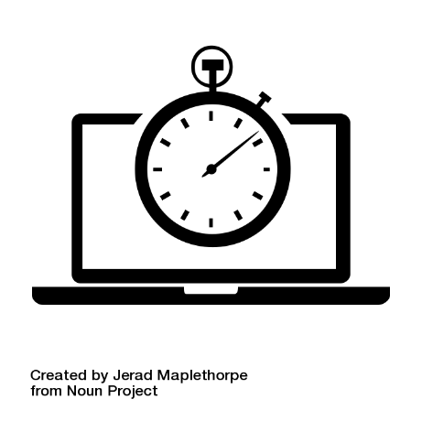
IBM Streams Analytics Fundamentals & Application Pattern
ACQUIRE Broad range of data types |  | ANALYZE Continuous multimodal analytics |  |  | ACT Right time, right method
INGEST Sensors Social Machine Data Location Audio Video Text |  | PREPARE Transform Filter Correlate Aggregate Enrich | DETECT AND PREDICT Classification Patterns Anomalies Scoring |  | DECIDE Business Rules Conditional Logic | ACT Notify Publish Execute Visualize
STORE SQL, NoSQL, Hadoop, operational store, files

Slide 10
IBM Streams Analytics Out of the box with over 200 operators with 1300 functions
Communications Data Sources
TCP/IP
UDP/IP
HTTP
FTP
RSS
Messaging Toolkit (Kafka, XMS, IBM MQ, Apache ActiveMQ, RabbitMQ, MQ TT, MQ Low Latency Messaging)
IBM Data Replication
Hadoop
Hadoop
HDFS, GPFS, Hive, Hbase, BigSQL, Parquet, Thrift, Avro
IBM Streams
Scale-out Runtime
RDBMS
IBM DB2, IBM DB2 Parallel writer, IBM Informix, IBM BigInsights BigSQL, IBM Netezza, IBM Netezza NZLoad, solidDB, Oracle, Microsoft SQL Server, MySQL, Teradata, Aster, HP Vertica
Data Warehouse
Primary Analytics
NoSQL
NoSQL
Key Value Stores (HyperState Accelerator, Memcached, Redis, Redis-Cluster, Aerospike)
Column Oriented Stores (Cassandra, Hbase)
Document Oriented Stores (IBM Cloudant, Mongo, Couchbase)
Filter
Enrich
Normalize
Windowed Aggregations
Machine Learning
Scoring (SPSS, Python, R, MLlib)
Signal Processing
CEP & Pattern Matching
xDR Mediation
Geospatial
Video/Image
Text Analytics (AQL)
Speech to Text
Rules
Deep Packet Inspection
Application Development
Java
Scala
Python
Streams Processing Language (Drag & Drop)
And even more at github.com/IBMStreams

Slide 11


Integrates Seamlessly with IBM MQ
Send push notifications
Transactions
Alerts
IBM MQ
IBM MQ connects mission-critical Systems of Record, requiring transactional, once-only delivery E.g. payment transactions
IBM Event Streams distributes and processes streams of events in real-time to intelligently engage with customers E.g. alerts on spending patterns

Slide 12
Unlock Events from Systems where Kafka Connectivity is a Problem
REST API for Inbound Data
IBM Event Streams
HTTP
z/OS Connect
HTTP
HTTP
REST API
Applications
12
Notes:
New REST api, to publish events to kafka without programming with lower level API.

Slide 13
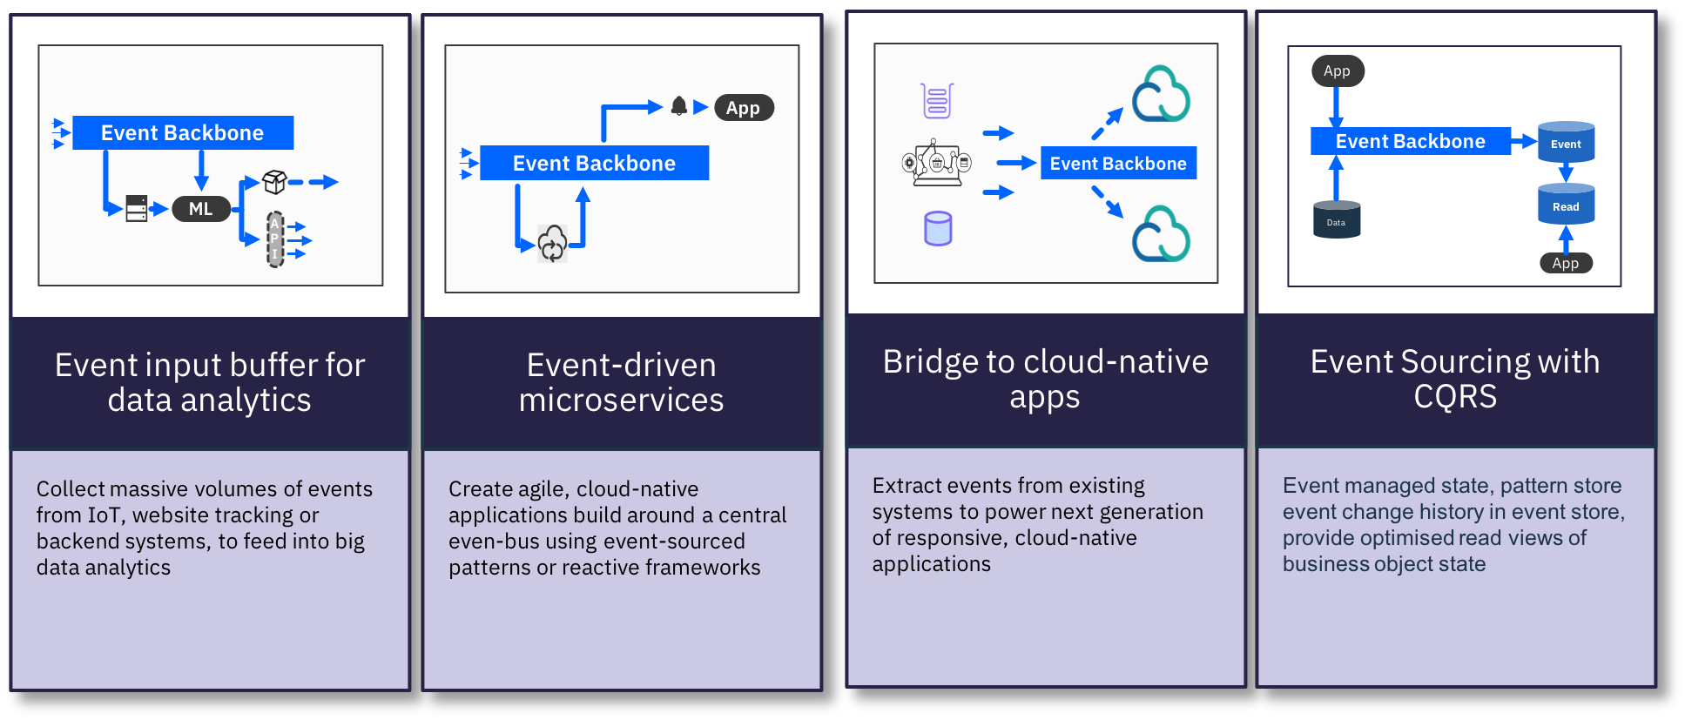
IBM Event Streams Event Driven Application Patterns

Slide 14
Event Sourcing: From a relational model…
Product ref
Quantity
Product type
Orders
Shipment Order
Product ref
Quantity
updates the previous state of business entities
Addresses
Shipping Address
Pickup Address
Products
https://ibm-cloud-architecture.github.io/refarch-eda/evt-microservices/ED-patterns/

Slide 15
To a sequence of events - Event Sourcing
Shipment Order
Created
Pickup Address
Added
3 Products
Added
Shipping Address
Updated
Order
Shipped
Immutable
Only append
Keep a log of all the changes
Time
https://ibm-cloud-architecture.github.io/refarch-eda/evt-microservices/ED-patterns/
Notes:
How many of you have delete statement in your database?
How do you define the data have no value?
How to do cost benefit analysis about information?

Slide 16
Event Sourcing
Shipment Order
Created
Pickup Address
Added
3 Products
Added
Shipping Address
Updated
Remove one Product
Does not loose information
Keep facts
Derive state from facts
Auditing
Time based query
Behavior pattern over time
Time
Notes:
Is it the same has having 2 products in the order?
It depends. If you consider the data in a relation manner it does equal to two products. If you want to count the number of time product are removed from an order than it matter to keep the event.

Slide 17

Event Sourcing
UI Web SPA
BFF
Immutable Ordered Events
Offset read / committed
Replay and auditability
Key example: OrderID
Order Mgt MS
USER
offset
Order
Publisher
Consumer
Order Created
Order Updated
Order Updated
Order Pending
Order Booked
Order Confirmed
Order Assigned
Order Shipped
Order In Transit
Order Delivered
Time

Slide 18
Event Sourcing
Order Mgt MS Pod
When a pod crashes, the new instance can reload from a previously committed offset, or from the last snapshot
offset
Order
Order Created
Order Confirmed
Order Shipped
Order In Transit
Snapshot
Order Delivered
Order Created
Order Updated
Order Updated
Order Confirmed
Order Shipped
Order Mgt MS
Pod
Time
https://chriskiehl.com/article/event-sourcing-is-hard

Slide 19
Integration tests to proof event sourcing
What happened to order ID 75?
Order producer
Simulator.py
Order Created
Order Confirmed
Order Shipped
Order In Transit
Snapshot
Order Delivered
Order Created
Order Updated
Order Updated
Order Confirmed
Order Shipped
Order consumer
Whathappen.py
Time
https://ibm-cloud-architecture.github.io/refarch-kc/itg-tests/ - replay-all-events-for-a-given-key

Slide 20
Order Life Cycle
Order Settlement
Order Delivery
Create Order
Order Created
Voyage found
Confirm Order
Update Order
Order Updated
Confirm Order
Order Booked
Order Completed
Allocate Voyage and
Container
Order Transit
Order Assigned
Cancel Order
Order Cancelled
Order Rejected
Notes:
It is important to work on the main business entity life cycle, assess the state and event notifications created when state changes.

Slide 21
Eventual Data Consistency

Slide 22
Command Query Responsibility Segregation

Slide 23

Command Query Responsibility Segregation Pattern
CRUD works for totally isolated data but becoming hard to do cross domain services with consistency
How to join data / entities ?
APIs
Order MS
Write Model
Read Model
Projection
Events
Data
https://github.com/ibm-cloud-architecture/refarch-kc-order-ms#command-query-responsibility-segregation-cqrs-pattern

Slide 24
Orders Microservice: Event Sourcing & CQRS
Order Dashboard Web
Order UI Web SPA
BUSINESS
USER
END
USER
Complex Queries
Add, read by ID,
update Order
Order Command MS
Order Queries MS
BFF
Event Backbone
0
1
2
3
4
5
6
7
Notes:
The order comes to the Command API and need to be saved to the DB and a “OrderCreated” event needs to be published… so what is the problem? You may fail to save to the DB but send to the topic, or you may save and fail to send to the topic…. So we need transaction…. But the event backbone does not support XA 2 phase commit transactions.

Slide 25

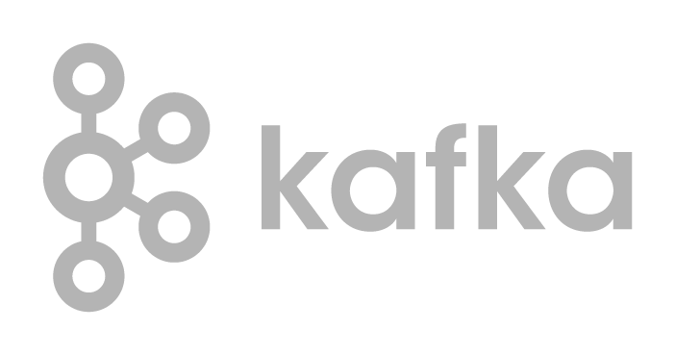
Command Query Responsibility Segregation Pattern
API Gateway
CRUD Q APIs
Order Service
Order Query MS
Order Query MS
Order Command MS
Order Query MS
Write Model
Read Model
Data
Projection
Projection
Projection
Events
orders
voyages
0
1
2
3
4
5
6
7
0
1
2
3

Slide 26
CQRS and CDC Pattern
Order Service
Order Query MS
Order Query MS
Order Command MS
Order Query MS
Write Model
Orders table
Read Model
Projection
Tx log
Projection
Projection
CDC Capture Agent
Events
orders
0
1
2
3
4
5
6
7

Slide 27
Command Query Responsibility Segregation Pattern
Order UI Web SPA
USER
Order Service
Order Command MS
CRUD APIs
Error Log
Write Model
Admin APIs
4
Consumer
DB
3
1
2
5
Events
Topic
0
1
2
3
4
5
6
7
CLI
6
https://github.com/ibm-cloud-architecture/refarch-kc-order-ms

Slide 28
OrderCommand Microservice main Class Diagram
@POST
Response create( OrderDTO o)
@PUT
Response update( OrderDTO o)
OrderCRUDService
emit( OrderEvent e)
handle( OrderEvent e)
EventEmitter
EventListener
handle( OrderEvent e)
@GET
Response getAll()
OrderAdminService
add( Order o)
getByID(String)
Update(Order o)
OrderDAO
ServletContextListener
KafkaConsumer delegates the event processing to OrderAdminService
EventLoop

Slide 29
Data Models
Order UI Web SPA
Order MS
Order id, addresses, customer id, product id, container id
Order specifics attributes
Status …
END
USER
{Customer id
Src and dest addresses
Product id,
Quantity,
Target delivery date }
OrderCreated
OrderCancelled
OrderUpdated
OrderBooked
OrderDelivered…

Slide 30
SAGA Pattern
A long running transaction that can be broken up to a collection of subtransactions that can be interleaved any way with other transactions. Src Garcia-Molina, Salem 1987
With microservice each transaction updates data within a single service, each subsequent step may be triggered by previous completion.
Order MS
Voyage MS
Container MS
Ship Mgt
1
Order Created
2
Order Booked
Allocate
Voyage
Assign
Containers
3
Update
Load
4
Order Assigned
5
6
Notes:
When the order is created, it can be updated at any time by the user until he books it for the final order. As soon as the order is booked, the process needs to allocate the voyage, assign containers and update the list of container to load for a voyage at the ship context level. Those actions / commands are chained. The Final state (in this schema not in the reality as the process has more steps) is the Order assigned state in the order microservice.
Consider the lost request and its idempotent execution. In the past, a form would have multiple carbon copies with a printed serial number on top of them. When a purchase-order request was submitted, a copy was kept in the file of the submitter and placed in a folder with the expected date of the response. If the form and its work were not completed by the expected date, the submitter would initiate an inquiry and ask to locate the purchase-order form in question. Even if the work was lost, the purchase-order would be resubmitted without modification to ensure a lack of confusion in the processing of the work. You wouldn’t change the number of items being ordered as that may cause confusion. The unique serial number on the top would act as a mechanism to ensure the work was not performed twice.

Slide 31
Saga pattern - Choreography
Each service produces and listens to other service’s events and decides if an action should be taken or not
Order MS
Voyage MS
Container MS
Ship MS
The distributed transaction ends when the last service executes.
Pending
5
2
3
4
1
orders
0
1
2
3
4
5
6
7
Notes:
the first service executes a transaction and then publishes an event. It maintains the business entity status, (order.status) to the pending state until it is completed. This event is listened by one or more services which execute local transactions and publish (or not) new events.
The distributed transaction ends when the last service executes its local transaction and does not publish any events or the event published is not heard by any of the saga’s participants.

Slide 32
Saga pattern - Choreography
In case of failure, the source microservice is keeping state and timer to monitor for the completion event.
Order MS
Voyage MS
Container MS
Ship MS
Error
1
2
orders
0
1
2
3
4
5
6
7
Notes:
Rolling back a distributed transaction does not come for free. Normally you have to implement another operation/transaction to compensate for what has been done before.

Slide 33
Saga pattern - Orchestration
One service is responsible to drive each participant on what to do and when.
Voyage commands
Voyage MS
Container MS
Ship MS
Order MS
Order
Orchestrator
0
1
2
3
4
5
0
1
2
3
4
0
1
2
3
4
5
Orders response
0
1
2
3
4
5
6
7
Notes:
If anything fails, it is also responsible for coordinating the rollback by sending commands to each participant to undo the previous operation.
orchestrator is a State Machine where each transformation corresponds to a command or message.
Rollbacks are a lot easier when you have an orchestrator to coordinate everything

Slide 34
Exception management
Technical exception
Retries
Timeout
Log for error handling
Admin API to replay from previous offset
Business exception (out of stock)
Compensation process

Slide 35
Saga
 | Choreography | Orchestration
Pros | + simple, does not require much effort to build + participants are loosely coupled. | Avoid cyclic dependencies between services Centralize the orchestration of the distributed transaction in one state machine Participants are simpler as they respond to command and send events
Cons | difficult to track which services listen to which events | Risk to have dump service and big brain orchestrator design command and response event structure
Fail over | Producers must ensure event delivery and idempotence to do not generate same order event multiple times Delivery once
Rollback | Create compensation plan
Notes:
Events/Choreography is a natural way to implement Saga’s pattern, it is simple, easy to understand, does not require much effort to build, and all participants are loosely coupled as they don’t have direct knowledge of each other.

Slide 36
Table Of Content
Why EDA in 2018?
Microservice Challenges
Reference Architecture
Kafka and Event Streams
Event Storming Methodology
Even-driven design patterns
Reference Implementation
Data replication for continuous availability
Real time analytics and AI

Slide 37
Coexistence

Slide 38





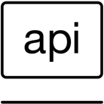
Mainframe / DB2 data to microservice
Mainframe core systems comprise batch jobs, online transactions, service components and user interfaces
The key organizing principle tends to be how and when code is executed
In cloud-native and microservices architecture, the organizing principles are based on domains, bounded contexts and aggregates.
https://www.ibm.com/cloud/garage/innovate/code/practices/domain-driven-design/
Notes:
without fully understanding what databases do today and the power that they bring and what relies on them — like transactions, concurrency, isolation, durability, materialized views, indexes — “We’re not fully understanding the principles of the decisions that were made of relational databases, [and] we can very quickly get into trouble reimplementing databases over API calls and implementing them much worse.
Bounded Context explicitly defines the boundaries of your model. This concept is critical in large software projects. A Bounded Context sets the limits around what a specific team works on and helps them to define their own vocabulary within that particular context. When you define a bounded context, you define who uses it, how they use it, where it applies within a larger application context, and what it consists of in terms of things like Swagger documentation and code repositories.

Slide 39
Coexistence integration patterns and tier 1 / tier 2 data
Standard Coexistence Integration Patterns
Current state core master data tables identified and categorized as tier 1 for increment planning
Current state reads modernized data directly (no transformation)
Modernized state updates current state data (reader support)
Current state reads modernized data (w/data transformation)
Current state updates modernized data
Modernized state reads current state data
Tier 1 Database Tables: Core master data tables identified as basis for modernized data model
Tier 2 Database Tables: Those tables that were NOT determined to be Core Master Data tables and are either application based, work tables, or temp tables. These tables may contain copies of core master table (tier 1) data from downstream operations
Requires modification when tier 1 programs are modified to read and process modernized data
Tier 1 Programs: Programs that perform update and / or read operations on the tier 1 tables
Tier 2 Programs: Programs that DO NOT perform any operations against the tier 1 tables, but receive core data downstream from either tier 1 programs or tier 2 tables
Requires modification when tier 1 programs are modified to read and process modernized data

Slide 40


1. Current state reads modernized data directly (no transformation)
Current State Application
Coexistence Integration
Modernized Application
Modernized to Current State
Transform services
Integration Services
Tier 2 Programs
Tier 1 Programs
Integration Layer
Modernized DB Read Service
MO
2
MO
1
Invoke Read Service
API
Data Services
MO
3
Modernized Data Model
DB
1
DB
2
Tier 2 Data
Tier 1 Data
Usage
Pros
Cons
Examples
When update effort for current state tier 1 and tier 2 components is minimal
When no other alternatives exist to take advantage of the modernized data model
Current state tables / views decommissioned
Makes full use of modernized data model (e.g. utilizes all game changer features)
Effort to change tier 1 and tier 2 components may be significant
Increases maintenance costs of modifying the modernized database
Current state tightly coupled to modernized data model - procedural code (current state) more difficult to change than modernized code
Current state needs to use expanded customer name & address
Current state needs to be expanded to handle > 999 items per invoice

Slide 41

2. Modernized state updates current state data (reader support)
Current State Application
Coexistence Integration
Option 1:
Transaction capture
Modernized Application
Modernized to Current State
Transform services
Integration Services
Tier 2 Programs
Tier 1 Programs
Integration Layer
Capture Update
Current State DB Update Service
MO
1
Data Services
Transform Engine
Modernized Data Model
DB
2
Apply Update
Capture Update
Option 2:
Change Data Capture (CDC)
Tier 2 Data
Tier 1 Data
Usage
Pros
Cons
Examples
When update effort for tier 1 and tier 2 components is too large for current modernization roll out scope
When the current state constraints are minimal
No current state tier 1 / tier 2 changes required
Coexistence service development typically less effort
Reuses design / develop efforts for data migration
Current state remains decoupled from modernized solution
Modernized data updates applied synchronously or asynchronously depending on performance needs
Current state tables / views remain
Current state constraints may inhibit use of all benefits of modernized data model (i.e. utilization of game changer features may be delayed to subsequent roll outs)
Critical reports need current state data format that cannot be changed in the timeframe planned for a given modernization roll out
Critical business owned applications need replica of current state key data that cannot be changed in the timeframe planned for a given modernization roll out

Slide 42
3. Current state reads modernized data (w/transformation)
Current State Application
Coexistence Integration
Modernized Application
Modernized to Current State
Transform services
Integration Services
Tier 2 Programs
Tier 1 Programs
Integration Layer
Modernized DB Read Service
MO
1
Invoke Read Service
API
Data Services
Transform Engine
Modernized Data Model
Tier 2 Data
Tier 1 Data
Usage
Pros
Cons
Examples
When modernized data to current state data transformation complexity minimal
When performance requirements allow real time transformation for reading modernized data from the current state
Current state tables / views decommissioned
Minimal change to tier 1 and no change to tier 2 programs
Reuses design / develop efforts for data migration
Current state remains decoupled from modernized solution
Potential performance impacts of converting data on the fly when transform is complex
Current state constraints may inhibit use of all benefits of modernized data model (i.e. utilization of game changer features may be delayed to subsequent roll outs)
Current state table(s) are eliminated, but an current state report program still needs new expanded field in modernized data (e.g. modified to use expanded customer name)
A status code, indicator, or flag value is needed on the current state that was transformed into a new value set when loaded to the modernized data model

Slide 43
4. Current state updates modernized data
Current State Application
Coexistence Integration
Option 1:
Transaction Capture
Modernized Application
Integration Services
Tier 2 Programs
Tier 1 Programs
Integration Layer
Option 1:
Transaction Capture
Apply Update
Trans-action Capture API
MO
1
Data Services
Transform Engine
Option 2:
Change Data Capture (CDC)
Option 2:
Change Data Capture (CDC)
Change Data Capture (CDC)
Modernized Data Model
DB
2
Current State to Modernized
Transform services
Apply Update
Tier 2 Data
Tier 1 Data
Modernized DB Update Service
Usage
Pros
Cons
Examples
When current state processes are required to update the modernized database that were not able to be rolled out, but the respective current state database table was decommissioned
To support the roll out of modernized data to a new modernized inquiry (read only) process where current state data needs to be “forward sync’d” to the modernized database.
Current state tables / views decommissioned
Minimal changes to tier 1 program(s), no changes to tier 2 programs
Reuses design / develop efforts for data migration
Current state remains decoupled from modernized solution
Potential performance impacts of converting data on the fly when transform is complex
Potential need to update asynchronously to minimize impact on current state
A complex batch job, in part or as a whole is not modernized along with a given modernization roll out, but a status code or aggregated value needs to be transformed and updated on the modernized database since the current state equivalent table was decommissioned
Forward sync’ing data from current state database to modernized database to support modernized inquiry processes.

Slide 44
5. Modernized state reads current state data
Current State Application
Coexistence Integration
Modernized Application
Integration Services
Tier 2 Programs
Tier 1 Programs
Data Services
Modernized Data Model
DB
2
Current State to Modernized
Transform services
Tier 2 Data
Tier 1 Data
Current State DB Read Service
Usage
Pros
Cons
Examples
When modernized solution needs data that has not yet been modernized
Supports incremental modernization roll out where modernized data and current state data can be brought together in context within the modernized application
None
The modernized solution needs customer data reflected in the modernized user interface that has not yet been added to the modernized data model (e.g. Customer Name)

Slide 45
Orders table to kafka
1 table to 1 topic mapping
Topic acts as a transaction log
DB operations are implemented by record writes to a Kafka topic
Legacy runtime
RDBMS
Orders
Orders
0
1
2
3
4
5
6
(24, (24, “abc”)),
[ primary_key, values]
Cloud native runtime clusters
source
(key,values)
sink
RDBMS
Notes:
Representing DB2 table to distinct Kafka topic
A unique row in a DB2 table is represented by the Kafka record’s “Key”
The “Kafka Key” is comprised of a subset of the columns in the DB2 table which make the row unique
The “Kafka Key” is comprised of a subset of the columns in the DB2 table which make the row unique
Could be a unique index or the primary index defined on the DB2 table
Also possible for the rows to logically be unique, needn’t be a created index
The Kafka record’s “Value” contains the current values for all columns in the row
The messages in a topic represent the changes to the rows of a table over time
At any given sample offset in the topic, taking the most recent value up to that point for each unique key in the topic gives the original DB2 table at that point
Sample offset most useful if at a transaction boundary
For table orders ( orderID int, anAttribute varchar (30))
A Kafka mapping might use orderID=24 as the key value.
The Topic for orders (Topic_orders) might consist of the following (key,value) pairs: (24, (24, “abc”)), (25,(25, “def”)), (24, (24, “ghi”))
The aggregate result of these records would be a table with 2 rows: (24, “ghi”), (25, “def”)
Operations are implemented by record writes to a Kafka topic
Deletes
•Kafka represents a delete as a record with a key and null for the value.
•To represent a delete of the row with i1 value 1, send the (key, value) pair (1, null)
•New users often confused when they view values and simply see null.
•Displaying the key portion of the record is useful. (print.key=true)
Updates
•If the value being updated is not part of the key, an update is simply an insert.
•To represent a row update of (1, “abc”) to (1, “ghi) send the (key, value) pair (1,(1, “ghi”))
•If the value being updated is a key, it is represented by a delete record and an insert record.
•To represent the update of row (1, “abc”) to (5, “abc”) send two (key, value) pair records (1, null) , (5, (5,“abc”))

Slide 46
Table operations
Table Operation | Kafka records | Example
Insert row | Publish (newKey, values) | (orderID:24, {orderID:24, name: smith})
Update row | Publish (existingKey, values) | (orderID:24, {orderID:24, name: smithy})
Delete row | Publish (existingKey, null) | (orderID:24, null)
Notes:
Deletes
•Kafka represents a delete as a record with a key and null for the value.
•To represent a delete of the row with i1 value 1, send the (key, value) pair (1, null)
•New users often confused when they view values and simply see null.
•Displaying the key portion of the record is useful. (print.key=true)
Updates
•If the value being updated is not part of the key, an update is simply an insert.
•To represent a row update of (1, “abc”) to (1, “ghi) send the (key, value) pair (1,(1, “ghi”))
•If the value being updated is a key, it is represented by a delete record and an insert record.
•To represent the update of row (1, “abc”) to (5, “abc”) send two (key, value) pair records (1, null) , (5, (5,“abc”))

Slide 47
Using kafka for table replication
General Advantages
Offload Processing
Aggregation of Data From multiple Sources
Common Platform for Staging to Other Data Consumers
Storage System For Duplicating Important Data
Buffer Unprocessed Messages
Offers Throughput and Low End-to-End Latency
Offers Real Time Processing and Retrospective Analysis
Can Correlate Streaming Feeds of Disparate formats

Slide 48
Using kafka for table replication
General Advantages
Can Correlate Streaming Feeds of Disparate formats
Flexibility of Input Source and Output Targets
Built in Stream Processing on Real Time Feeds
Flexibility Supporting Business Logic Layering Or Programmatic Interpretation
Commit Log
Statistics
Red Flag Monitoring
Fault Tolerance, Scalability, multi-tenant nature, speedy, light-weight, landing-zone

Slide 49
Challenges
Format Choice
A Kafka record Key and Value are bytes
Producer and Consumer must come to an agreement about the meaning of the bytes in the key/value
Producers may have written data months before a consumer receives it
Communicating Table Schema
Records in a topic are relevant in the context of a specific schema
What if a tables schema were to change?
How can a consumer know the schema at the time the record was sent?
Network throughput maximization
Consumer processing considerations
Notes:
A Kafka record Key and Value need only be bytes to satisfy the Kafka Producer/Consumer protocol
Producer and Consumer must come to an agreement about the meaning of the bytes in the key/value
Producers may have written data months before a consumer receives it
Network throughput maximization
Consumer processing considerations
Communicating Table Schema
Records in a topic are relevant in the context of a specific schema
What if a tables schema were to change?
How can a consumer know the schema at the time the record was sent?
•Tracking the effective point in a source transaction operation sequence that has been applied to Kafka
•Non ACID target
•“at least once” semantics

Slide 50
Challenges
Tracking the effective point in a source transaction operation sequence that has been applied to Kafka
Non ACID target
“at least once” semantics
Notes:
•Tracking the effective point in a source transaction operation sequence that has been applied to Kafka
•Non ACID target
•“at least once” semantics

Slide 51
IBM DR Architecture
Legacy runtime
Business App
Replication Solution
RDBMS
Management console
RDBMS
Server
Server
doc
Orders
Capture Agent
messaging
Apply / Transform Agent
[ primary_key, values]
logs
Network
Data lake
Store procedure

Slide 52

IIDR Architecture on k8s? (N/A)
Legacy runtime
IIDR management console
Business App
Worker Node
RDBMS
Worker Node
Server
Worker Node
Worker Node
RDBMS
Kubelet
Kubelet
doc
IIDR Capture Agent
Orders
IIDR Kafka Agent
IIDR Access Server
orders
[ primary_key, values]
Kafka
Kafka Connect Sink
Data lake
logs
PV - metadata
Zookeeper
Store procedure

Slide 53
IIDR Architecture on k8s? (N/A)
IIDR management console
Legacy runtime
Business App
Worker Node
Worker Node
Worker Node
Worker Node
Worker Node
RDBMS
Kubelet
Kubelet
Kubelet
Orders
IIDR Access Server
IIDR Capture Agent
[ primary_key, values]
Kafka
RDBMS
Kafka Connect Sink
logs
IIDR Kafka Agent
Zookeeper
Store procedure
PV - metadata

Slide 54
Mainframe / DB2 data to microservice - refactoring
Revisit existing function and procedure and elaborate service interface
Service boundaries are not part of an entity or aggregate.
Mainframe functions could become operation of a service
Business rules should be externalized with their own life cycle and runtime as service
Mainframe
Cobol procedure
RDBMS
Cobol procedure
SQL proc
Domain Boundary /
Functions Refactoring
Cluster nodes
Business rules refactoring
Business Rules
As service
Order Microservice
Notes:
without fully understanding what databases do today and the power that they bring and what relies on them — like transactions, concurrency, isolation, durability, materialized views, indexes — “We’re not fully understanding the principles of the decisions that were made of relational databases, [and] we can very quickly get into trouble reimplementing databases over API calls and implementing them much worse.

Slide 55
Integrate DB2 data to event backbone (option 1)
Existing Clients
Applying CQRS and event sourcing
Mainframe
Order Query MS
New Clients
RDBMS
Cobol procedure
Write Model
API Gateway
Read Model
SQL proc
Kafka producer
Projection
Theory!
Orders
0
1
2
3
4
5
6
7
1 table to 1 topic mapping
Notes:
Attention this theory and nice on the slide. The cobol code is modified to generate events… Transaction boundary is lost anyway as there is no XA tx in kafka. But there is a may be a less intrusive ways to make it.

Slide 56
Kafka connect architecture
Legacy runtime
Connect Cluster
Broker Server
Kafka Streams
RDBMS
Worker
KStream - KTable
containers
Orders
Worker
a b c d e
Broker Server
[ primary_key, values]
Broker Server
Worker
Sink

Slide 57
Integrate DB2 data to event backbone (option 2)
Existing Clients
Mainframe
Transform Data Models
Order Query MS
RDBMS
Cobol procedure
Write Model
New Clients
API Gateway
Read Model
SQL proc
Projection
Change Data
Capture
Transform Data Models
Orders
0
1
2
3
4
5
6
7
IBM Data Replication CDC
CDC Replication Engine for Kafka

Slide 58

Integrate event backbone using MQ (option 3)
Existing Clients
Mainframe
Transform Data Models
Order Query MS
RDBMS
Cobol procedure
Write Model
New Clients
API Gateway
Read Model
SQL proc
MQ
Projection
Transform Data Models
Orders
0
1
2
3
4
5
6
7
IBM Data Replication CDC
CDC Replication Engine for Kafka

Slide 59
Coexistence
Can you run both at the same time
Separate UI
Any shared data or tasks?
All complex queries can be moved to microservice and run on eventually consistent data.
Migrate the transactional processing when necessary, as it is more complex

Slide 60
IBM Event Streams | Integrates with IBM MQ
Send push notifications
Transactions
Alerts
IBM MQ connects mission-critical Systems of Record, requiring transactional, once-only delivery, e.g. payment transactions
IBM Event Streams distributes and processes streams of events in real-time to intelligently engage with customers, e.g. alerts on spending patterns
Notes:
Written by, and supported by, experts in both MQ and Kafka/Event Streams
Built-in understanding of MQ enterprise deployments, for example to handle high availability configurations and maintenance regimes
Well-tuned connectors (source and sink) which take messages off an MQ queue and streams them onto a Kafka topic and vice versa
Anything additional is left in the hands of the MQ operations team, so they get no surprises in MQ resource usage
Confluent only supports 1-way connectivity. Their connector can also result in poor use of MQ topic subscriptions or message selectors leaving messages building up unchecked
IBM’s unique knowledge of MQ message structures has enabled the connectors to extract event info from a range of message formats, and put the right data onto Kafka topics, including custom records if needed
IBM has added support for the MQ connectors to run directly on IBM z/OS so they can take advantage of bindings mode for improved operational efficiencies

Slide 61
Kafka Connect MQ Source connector
Open-source – build it yourself
Use any supported MQ release
Uses JMS client internally
Client connections
Supports TLS, authentication
MQ queue->Kafka topic
Support for binary, text, JSON
Easy to extend
MQ Source connector
RecordBuilder
Converter
TO.KAFKA.Q
FROM.MQ.TOPIC
MQ Message
SourceRecord
Kafka Record
MQMD
Schema
Null key
(MQRFH2)
Value
(may be complex)
Value
byte[]
Payload
https://github.com/ibm-messaging/kafka-connect-mq-source

Slide 62
Kafka Connect MQ Sink connector
Open-source – build it yourself
Use any supported MQ release
Uses JMS client internally
Client connections
Supports TLS, authentication
Kafka topic -> MQ queue
Support for binary, text, JSON
Easy to extend
MQ Sink connector
Converter
MessageBuilder
TO.MQ.TOPIC
FROM.KAFKA.Q
Kafka Record
SinkRecord
MQ Message
Key
Schema
MQMD
Value
byte[]
Value
(may be complex)
(MQRFH2)
Payload
https://github.com/ibm-messaging/kafka-connect-mq-sink

Slide 63
Table Of Content - Why EDA in 2018 - Microservice Challenges - Reference Architecture - Even-driven design patterns - Reference Implementation - Real time analytics and AI - Event Storming Methodology
Architecture
Continuous Availability
Disaster recovery
Security
Scaling
CI/CD
Servicing

Slide 64
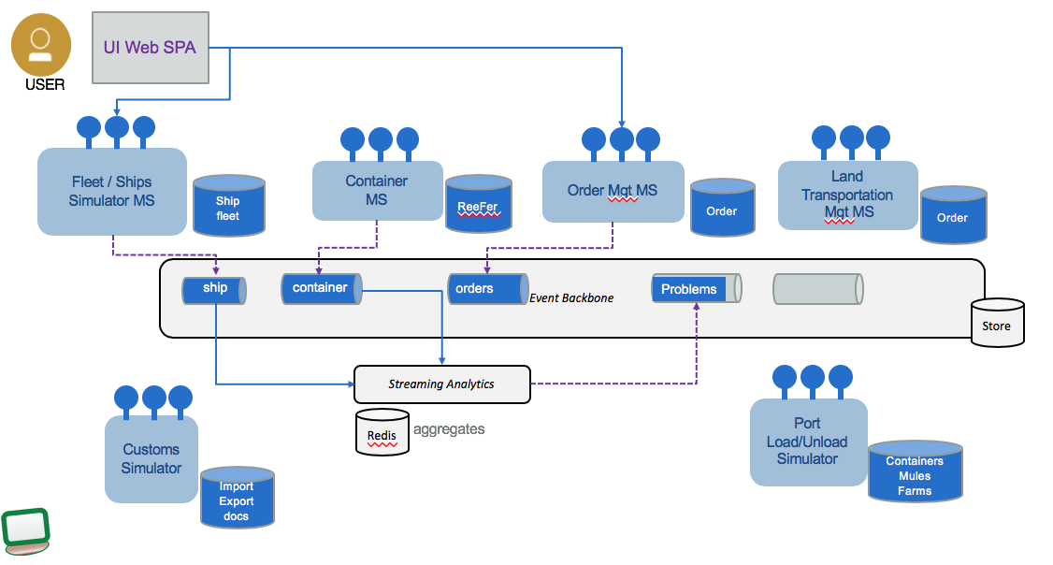
Reference Implementation
Shows solution design process with Event and Insight Storming.
Shows event driven microservices implementing Event Sourcing and CQRS application patterns.
Demonstrate streaming analytics and intelligent apps pattern with machine learning
https://ibm-cloud-architecture.github.io/refarch-kc

Slide 65
Fleet Simulator

Slide 66
Container Microservice - KStreams
Manage Container Inventory, APIs to access the inventory and consumer of ContainerEvent.
Kstreams implementation (Java – Open Liberty – JAXRS)
Container microservice as KStreams
KStream - KTable
OpenLiberty
Containers
0
1
2
3
4
5
6
7

Slide 67
Container Microservice - KStreams
Assign container to orders
Containers
0
1
2
3
4
5
6
7
Container microservice as KStreams
KStream - KTable
containers
City-containers
Orders
Kstreams - orders
0
1
2
3
4
5
OpenLiberty

Slide 68


Container Microservice – Springboot - Postgresql
Kafka data source, web, kafka template.
Containers
0
1
2
3
4
5
6
7
Container microservice Springboot
containers
Consumer - containers
City-containers
Orders
Consumer - orders
0
1
2
3
4
5
Tomcat

Slide 69
Container Microservice – Springboot - Postgresql
4
3
Producer
Consumer
2
psql
Containers
0
1
2
3
4
5
6
7
1
Container microservice Springboot
containers
Consumer - containers
Producer
Producer
6
City-containers
Orders
Consumer - orders
Producer
0
1
2
3
4
5
6
Tomcat
Consumer
5

Slide 70
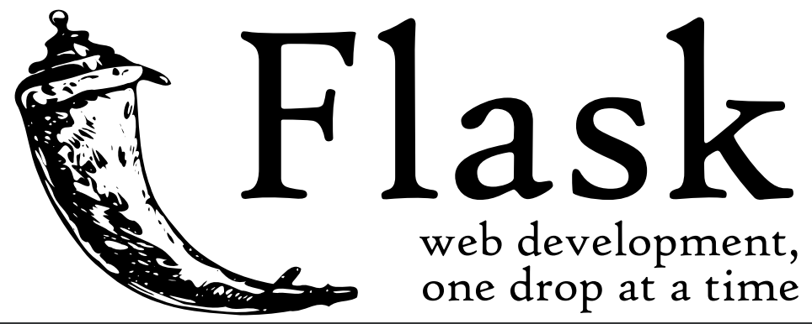
Container Microservice - Python
Manage Container Inventory, APIs to access the inventory and consumer of ContainerEvent.
Python Flask, Kafka python API
Container microservice
Kafka Consumer
Python Flask
Containers
0
1
2
3
4
5
6
7

Slide 71
Table Of Content - Why EDA in 2018 - Microservice Challenges - Reference Architecture - Even-driven design patterns - Reference Implementation - Real time analytics and AI - Event Storming Methodology
Architecture
Continuous Availability
Disaster recovery
Security
Scaling
CI/CD
Servicing

Slide 72
Integrate to Partition from ML env
ContainerMetrics
Jupiter notebook
0
1
2
3
4
5
6
7
Training Set
Test Set
Simulator
Create Container Metrics
Maintenance Manual Transcript Notes
Model
Scoring risk of failure in next x hours
Predictive maintenance
Data Scientist focus

Slide 73
Intra cluster High Availability
orders-topic
Broker Server 1 – Rack 1
Z7r-PV
K3a-PV
Partition 1 Replica 1
Partition 2 Replica 1
Broker Server 2 – Rack 2
Z7r-PV
K3a-PV
Partition 1 Replica 2
Partition 2 Replica 3
Broker Server 3 – Rack 3
Z7r-PV
K3a-PV
Partition 1 Replica 3
Partition 2 Replica 2
ZooKeeper Ensemble
Node 1- Rack 1
Node 2 - -Rack 2
Node 3 – Rack 3
Dual network

Slide 74
Master Node
Proxy
Worker
Worker
Worker
Proxy
Master Node
Proxy
Master Node
Calico
FileBeat
Calico
FileBeat
Calico
FileBeat
API-Server
Kubelet
K8S proxy
Kubelet
K8S proxy
Kubelet
K8S proxy
Authentication
webapp
webapp
webapp
Calico
DNS
Event Driven Microservice
Event Driven Microservice
Event Driven Microservice
Proxy
Helm repo
Image Repo
Proxy
Logging Monitoring
Management
ICP router
Worker
Worker
Worker
Kubelet
FileBeat
Calico
FileBeat
Calico
FileBeat
Calico
FileBeat
Kubelet
K8S proxy
Kubelet
K8S proxy
Kubelet
K8S proxy
Scheduler
Kafka broker
Kafka broker
Kafka broker
Zookeeper
Zookeeper
Zookeeper
etcd
Z7r-PV
K3a-PV
Z7r-PV
K3a-PV
Z7r-PV
K3a-PV

Slide 75
High Availability: Active – (P/C) Standby
Data Center 1
Data Center 2
LB
LB
orders-topic
orders-topic
Broker 1
Broker 1
Partition 1 Replica 1
Partition 2 Replica 1
Partition 1 Replica 1
Partition 2 Replica 1
Producer
Broker 2
Partition 1 Replica 2
Partition 2 Replica 3
Consumer
Broker 2
Partition 1 Replica 2
Partition 2 Replica 3
Producer
Consumer
Broker 3
Broker 3
Partition 1 Replica 3
Partition 2 Replica 2
DB
Partition 2 Replica 2
Partition 1 Replica 3
Mirroring
Master
Slave
Notes:
One topic, 2 partitions, 3 replicas, 1 consumer group with two consumers.

Slide 76
High Availability: Active - Active
Data Center 1
Data Center 2
IBM Cloud
ICP
Dc1-orders-topic
Dc2-orders-topic
Broker 1
Broker 1
Producer
Partition 1 Replica 1
Partition 2 Replica 1
Partition 1 Replica 1
Partition 2 Replica 1
Broker 2
Producer
Broker 2
Partition 1 Replica 2
Partition 2 Replica 3
Consumer
Consumer
Partition 1 Replica 2
Partition 2 Replica 3
Consumer
Producer
Consumer
Broker 3
Broker 3
Partition 1 Replica 3
Partition 2 Replica 2
Partition 1 Replica 3
Partition 2 Replica 2
Mirroring
Mirroring
Notes:
An event added to the dc1-order-topic is consumed locally, but mirrored to the second data center

Slide 77
Reliability
Producer can choose acknowledgement level (request.required.acks)
0 Fire-and-forget, fast but risky
1 Waits for 1 broker to acknowledge
-1 All Waits for all replica brokers to acknowledge
Producer can choose whether to retry
0 Do not retry, lose messages on error
>0 Retry, might results in duplicates on error
Producer can also choose idempotence
Means that retries can be used without risk of duplicates

Slide 78
Reliability
Consumer can choose how to commit offsets
Automatic: commits might go faster than processing
Manual, asynchronous: Fairly safe, but could re-process messages
Manual, synchronous: Safe, but slows down processing
A common pattern is to commit offsets on a timer
Exactly-once semantics
Can group sending messages and committing offsets into transactions
Primarily aimed at stream processing applications

Slide 79
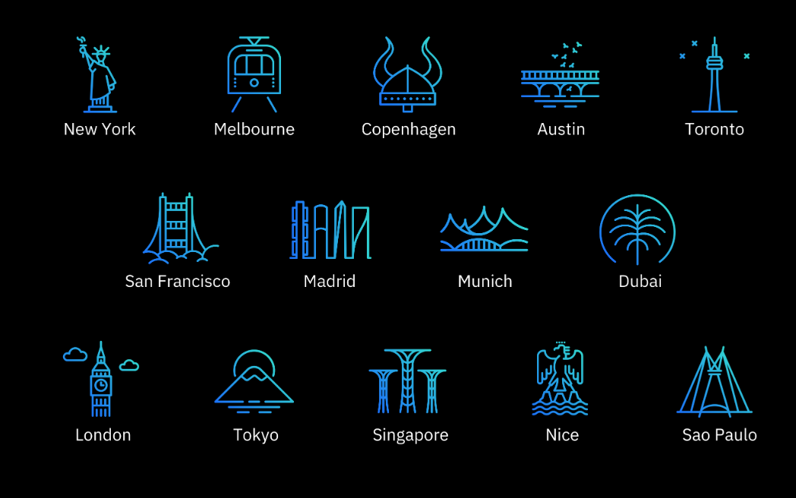
IBM Garage Locations

Slide 80

Local Environment
Docker compose kc-solution
Docker network
Docker compose backbone
UI
FleetMS
ZooKeeper
Order Command MS
Postgresql
Order Query MS
Voyage MS
Container MS
containers

